Slide 1

British Airways Customer Review Sentiment Analysis
• Analyzed 1,000+ customer reviews scraped from Skytrax
• Applied web scraping, sentiment analysis (VADER), and NLP
• 52% Negative, 46% Positive, 2% Neutral
• Top complaints: delays, staff behavior, luggage issues
• Top praises: business class, crew service, food
• Tools: Python, BeautifulSoup, Pandas, VADER, Seaborn

Slide 2
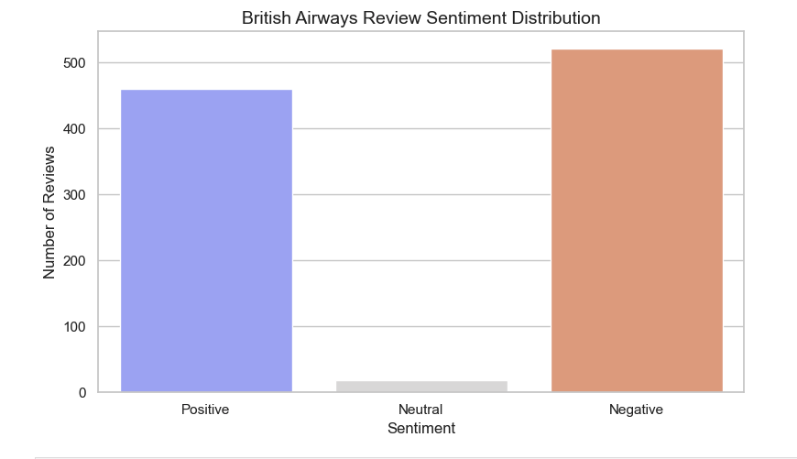
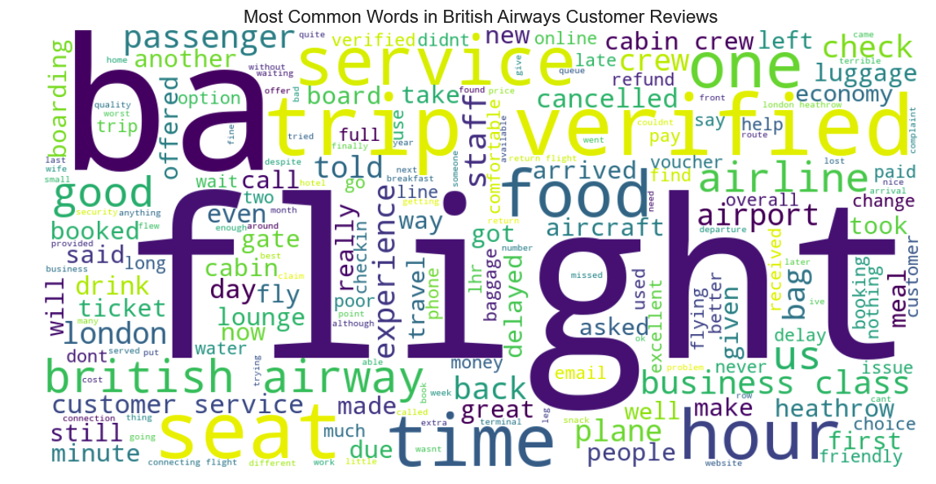
British Airways Review Analysis: Insights from 1,000+ Customer Experiences

